Slide 2
Are You Saved?
Saved from What?

Slide 3
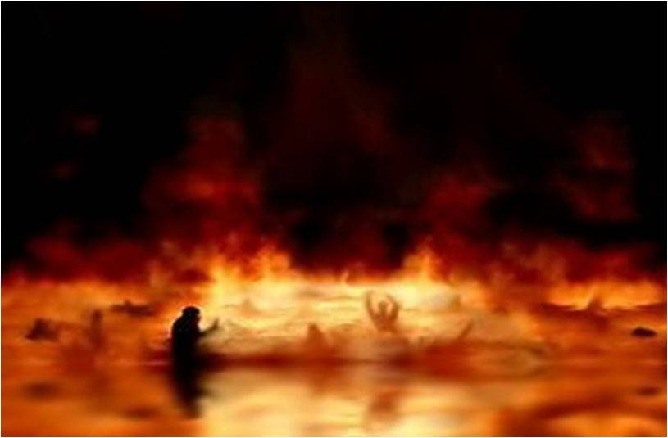
Are You Saved?
Saved from What?
Hell

Slide 4
Are You Saved?
Saved from What?
Lake of Fire
Eternal Damnation
The Second Death

Slide 5
Are You Saved?
Saved from What?

Slide 6
Are You Saved?
Saved from What?

Slide 7
Are You Saved?
Saved from What?

Slide 8
Context - exegesis
Saved from What?

Slide 9
Are You Saved?
Pretext - eisegesis

Slide 10
Are You Saved?
Saved from What?
Saved - 48x’s OT (NKJV)

Slide 11
“But the midwives feared God, and did not do as the king of Egypt commanded them, but saved the male children alive…” (Exodus 1:19)

Slide 12
“Before the coming of the great and awesome day of the LORD. And it shall come to pass that whoever calls on the name of the LORD Shall be saved.” (Joel 2:30-32)

Slide 13
Are You Saved?
Saved from What?
Salvation – “yeshuw” 131x’s OT (NKJV)

Slide 14
“And Moses said to the people, ‘Do not be afraid. Stand still, and see the salvation of the LORD, which He will accomplish for you today.” (Exodus 14:13)

Slide 15
“The One who gives salvation to kings, Who delivers David His servant from the deadly sword.” (Psalm 144:10]

Slide 16
“O GOD the Lord, the strength of my salvation,
You have covered my head in the day of battle.” (Psalm 140:7]

Slide 17
Are You Saved?
Saved from What?
Saved “sozo” 109x’s NT

Slide 18
Jesus said, “I am the door. If anyone enters by Me, he will be saved…” (John 10:9a)

Slide 19
Jesus said, “…for I did not come to judge the world but to save the world.” (John 12:47b)

Slide 20
Are You Saved?
Saved from What?
Salvation “soteria” 46x’s NT

Slide 21
In the NT only 30% of the uses of salvation or saved refer to salvation from eternal condemnation or obtaining eternal life.

Slide 22
70% of the uses of salvation or saved
in the NT refers to deliverance from calamities in this life.

Slide 23
“And suddenly a great tempest arose on the sea, so that the boat was covered with the waves. But He was asleep. Then His disciples came to Him and awoke Him, saying, ‘Lord, save us! We are perishing!” (Mt. 8:24-25)

Slide 24
“Peter had come down out of the boat, he walked on the water to go to Jesus. But when he saw that the wind was boisterous, he was afraid; and beginning to sink he cried out, saying, "Lord, save me!” (Mt. 14:29-30)

Slide 25
“And the soldiers' plan was to kill the prisoners, lest any of them should swim away and escape. But the centurion, wanting to save Paul, kept them from their purpose…” (Acts 27:42-43)

Slide 26
“And the prayer of faith will save the sick, and the Lord will raise him up…” (James 5:15)

Slide 27
“Brethren, if anyone among you wanders from the truth, and someone turns him back, let him know that he who turns a sinner from the error of his way will save a soul from death…” (James 5:19-20)

Slide 28
Salvation
in the Book of
Romans

Slide 29
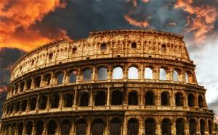
Salvation in Romans
The primary use of salvation in Romans is deliverance from the consequences of God’s temporary displeasure or anger against all sinful attitudes and conduct of men, [described in 1:18-32]

Slide 30
Salvation in Romans
Salvation - 4x’s
1:16; 10:10-11; 13;11

Slide 31
Salvation in Romans
Salvation - 4x’s
1:16; 10:10-11; 13;11
Save – 9x’s
5:9-10, 8:24; 9:27; 10:1,9,13 11:14, 26

Slide 32
Salvation in Romans
3:21 - 4:24
Justification by Faith Alone
Salvation from eternal condemnation

Slide 33
Salvation in Romans
There is not a single use of the word save and salvation in the justification section 3:21 - 4:24

Slide 34
Salvation in Romans
Salvation in Romans
is salvation
from God’s Wrath

Slide 35
Salvation in Romans
“Much more then, having now been justified by His blood, we shall be saved from wrath through Him.” (5:9)

Slide 36
Salvation in Romans
“For the wrath of God is revealed from heaven against all ungodliness and unrighteousness of men, who suppress the truth in unrighteousness,” (1:18)

Slide 37
Salvation in Romans
What is the Wrath of God?

Slide 38
Salvation in Romans
There is not a single use connecting God’s Wrath to the lake of fire
or eternal punishment.

Slide 39
Salvation in Romans
The wrath of God is His temporary displeasure or anger over all sinful attitudes and conduct of men, believers and unbelievers alike.

Slide 40
Salvation in Romans
Believers can experience the wrath of God!
Believers will escape the wrath of God that is to come upon the whole earth.

Slide 41
Salvation in Romans
“Much more then, having now been justified by His blood, we shall be saved from wrath through Him.” (5:9)

Slide 42
Salvation in Romans
“For if when we were enemies we were reconciled to God through the death of His Son, much more, having been reconciled, we shall be saved by His life” (5:10)

Slide 43
Salvation in Romans
Our salvation from
God’s wrath in this life is achieved by means of Jesus’ resurrection life empowering our lives
Chapters 5-8

Slide 44
Salvation in Romans
“…He who raised Christ from the dead will also give life to your mortal bodies through His Spirit who dwells in you.” (8:11b)

Slide 45
Salvation in Romans
“For I am not ashamed of the gospel of Christ, for it is the power of God to salvation for everyone who believes for the Jew first and also for the Greek…” (1:16-17)

Slide 46
Salvation in Romans
“For whoever calls on the name of the LORD shall be saved.” (10:13; Quoting Joel 2:32)
The context of Joel is
“The Day of the Lord”

Slide 47
Salvation in Romans
“How then shall they call on Him in whom they have not believed? And how shall they believe in Him of whom they have not heard? And how shall they hear without a preacher? And how shall they preach unless they are sent?” (10:13)

Slide 48
Salvation in Romans
The message is preached, then, it is heard then, believed. And then those who believed, call on the Lord in order to be saved from calamity in this life.

Slide 49
“that if you confess with your mouth the Lord Jesus and believe in your heart that God has raised Him from the dead, you will be saved. For with the heart one believes unto righteousness, and with the mouth confession is made unto salvation.” (10:9-10)

Slide 50
Salvation in Romans
These verses discuss both justification “believes unto righteousness”, and salvation/deliverance from wrath “confess with your mouth”.

Slide 51
Salvation in Romans
Justification is received by faith alone in Christ alone.

Slide 52
Salvation in Romans
Justification is received by faith alone in Christ alone.
Salvation (in Romans) is by faith plus confessing Christ
“For "whoever calls on the name of the LORD shall be saved.” (10:13)

Slide 53
Salvation in Romans
“And so all Israel will be saved, as it is written: ‘The Deliverer will come out of Zion, and He will turn away ungodliness from Jacob;” (11:26)

Slide 54
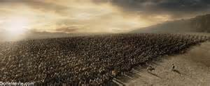
Salvation in Romans
God promises to save the nation of Israel from extinction.

Slide 55
Salvation in Romans
Conclusion

Slide 56
Salvation in Romans
God accepts us as righteous people on the basis of our faith in His Son
God approves of us on the basis of our walk in the newness of life

Slide 57
Salvation in Romans
Are You Saved?
“The just shall live by faith.“ (1:17)
Those who are justified by faith can also live and be saved from wrath, by calling on the Lord.

